Slide 1

Generative Adversarial Networks
(GANs)
Tejas Pradhan

Slide 2
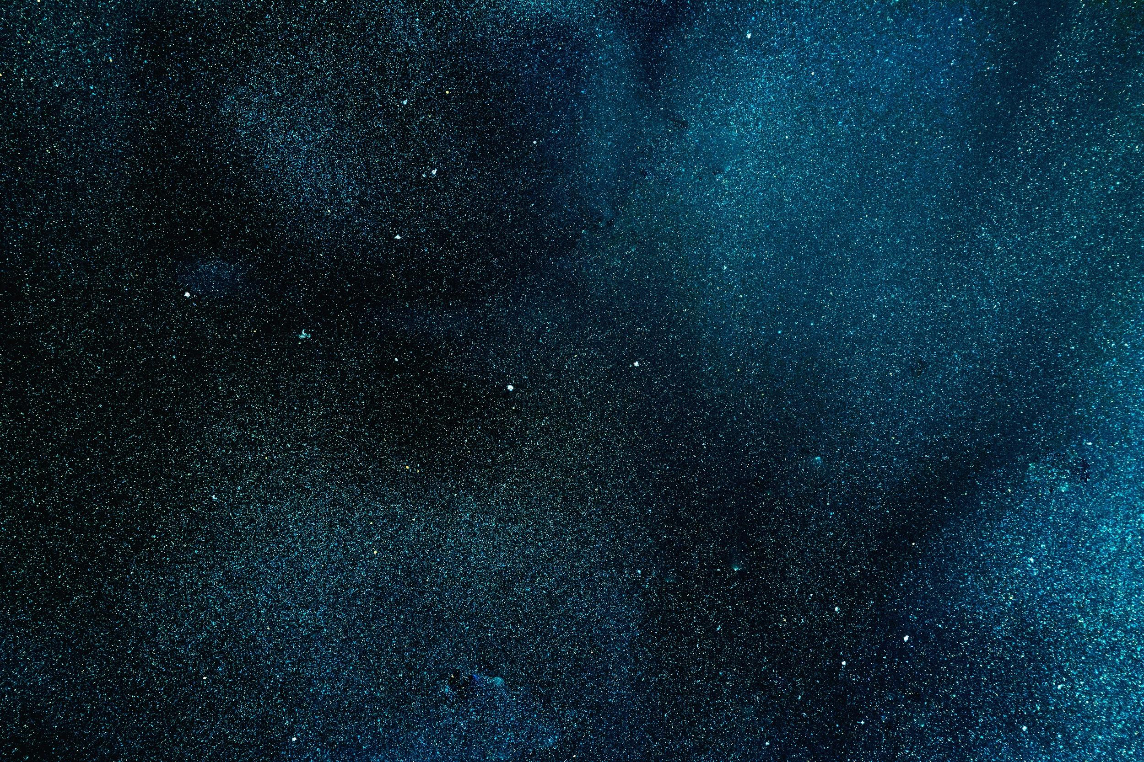
Let’s Review
Deep Learning

Slide 3

Generative Models
01

Slide 4
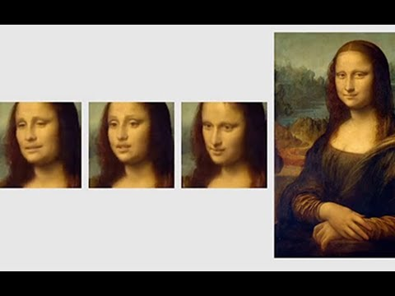
Generative Models

Slide 5
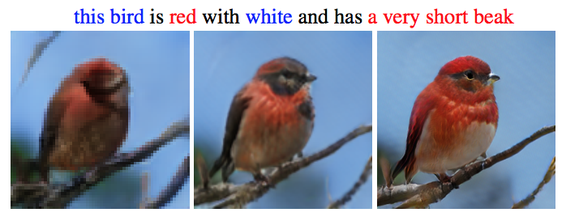
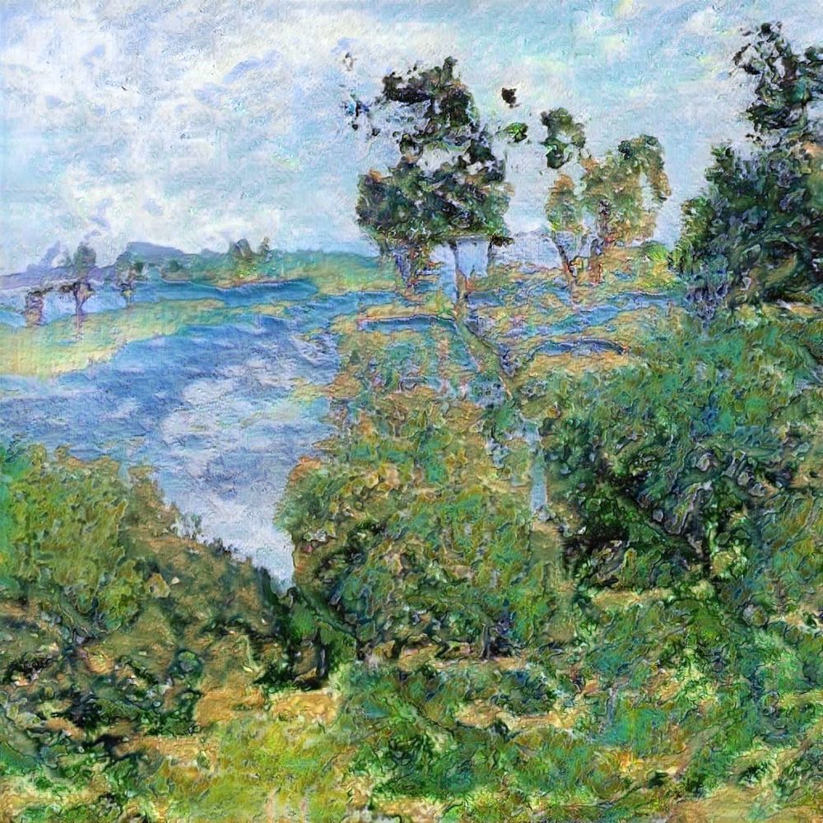
Applications Of Generative Models
AI Generated Paintings
(NST)
Text to image generator
Generative Chatbots
Enhancing Image Resolution
Image to Image Transformers
Generating Video Frames
Image Captioning

Slide 6
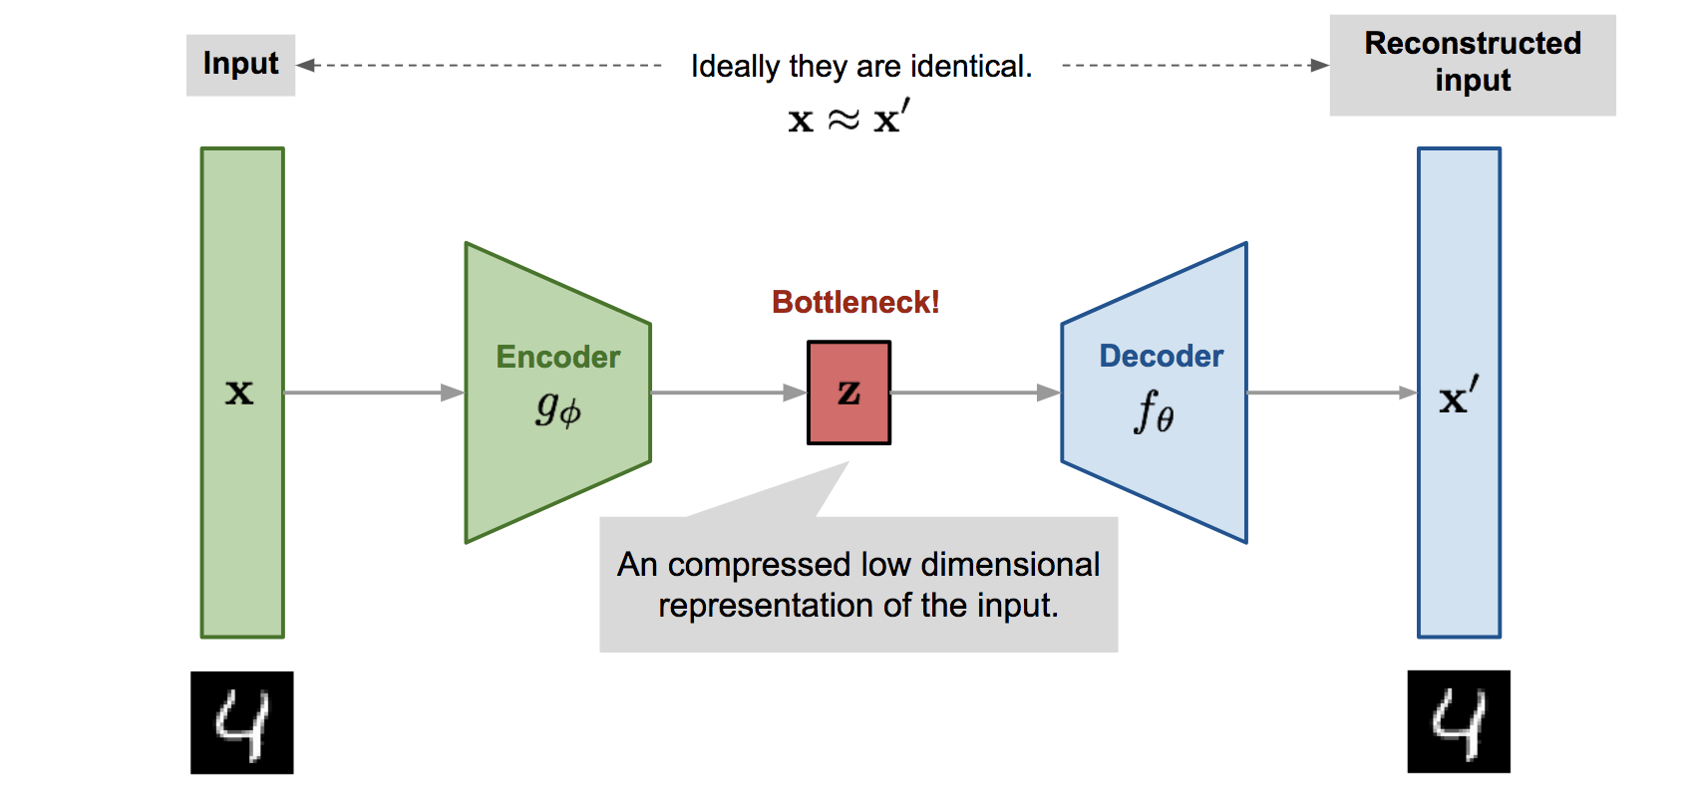
Generative Models

Slide 7
Introduction to GANs
02

Slide 8
Components of A GAN
Generator (G)
A neural network which generates fake data
Tries to learn the distribution of input data
Discriminator (D)
A neural network which discriminates between samples which are from the input data and generator
Tries to accurately label the data as ‘real’ or ‘fake’

Slide 9


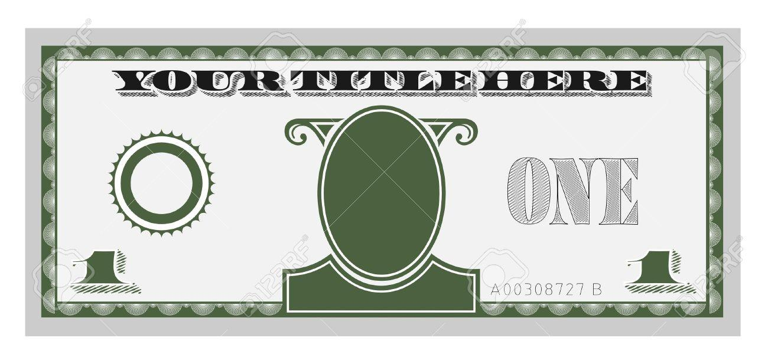
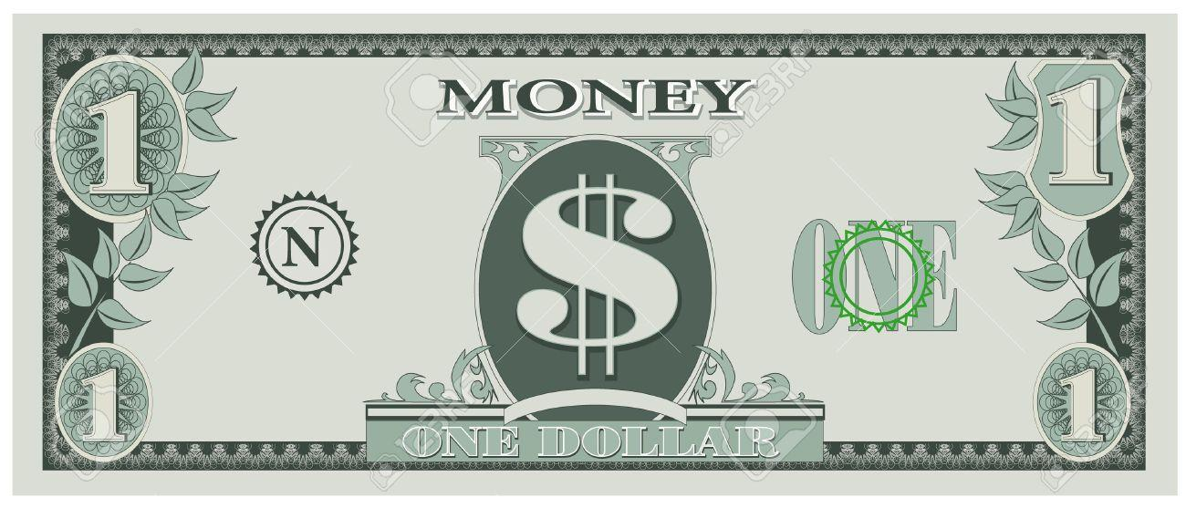
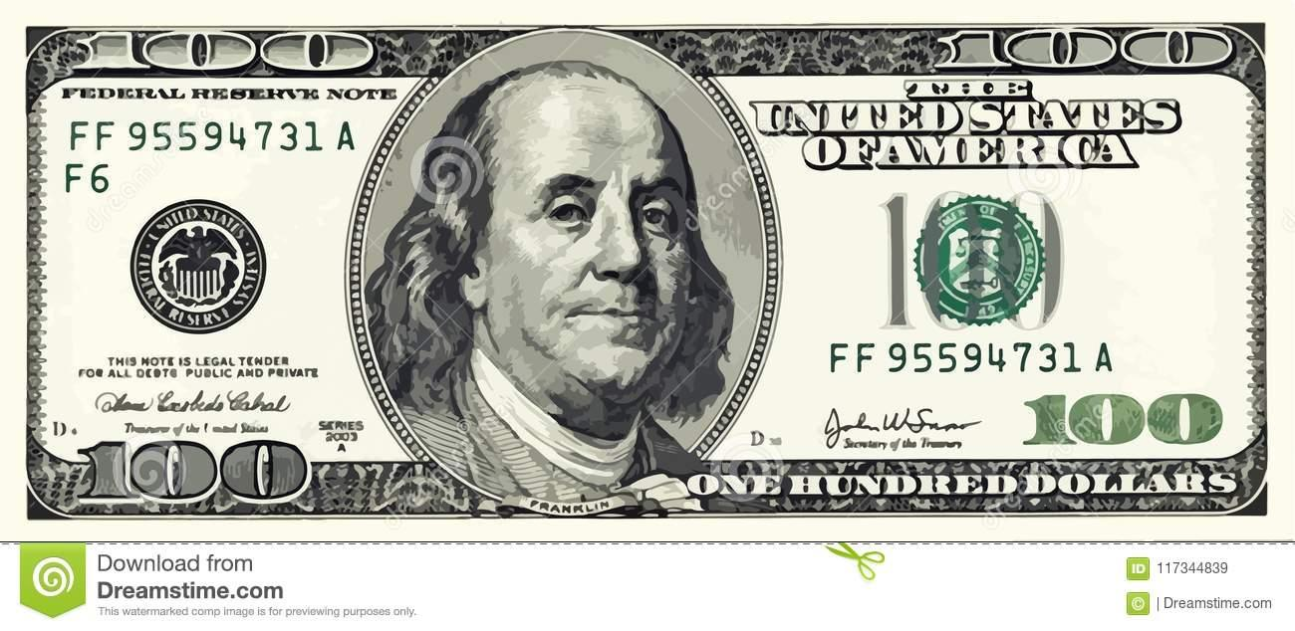
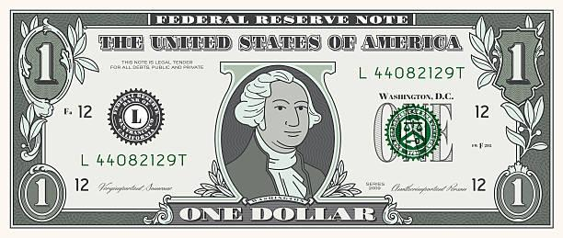
Nope!
Hell No!
Still No!
This is real money
Alright!
(Still fake)
Generator
Discriminator

Slide 10
Vanilla GAN Architecture
03

Slide 11
Standard Conventions
(As used by Goodfellow et. al.)
P_{x} - Input Data Distribution
P_{g} - Generator’s Data Distribution
P_{z} - Noise Distribution
G(z) - Sample outputted by G for input noise z
D(x) - Probability that a point x is classified as real by the discriminator

Slide 12
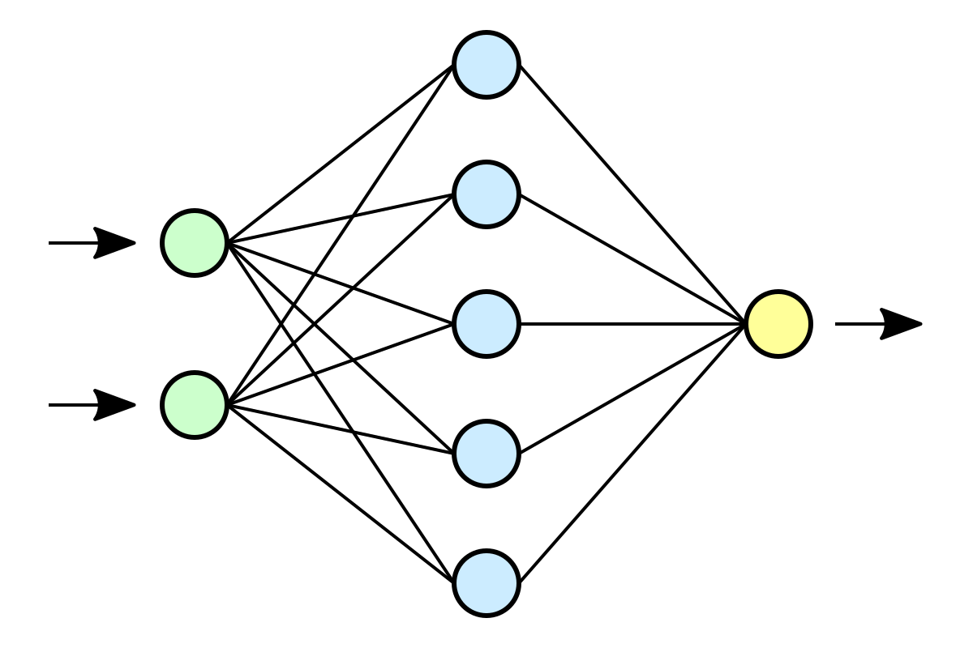
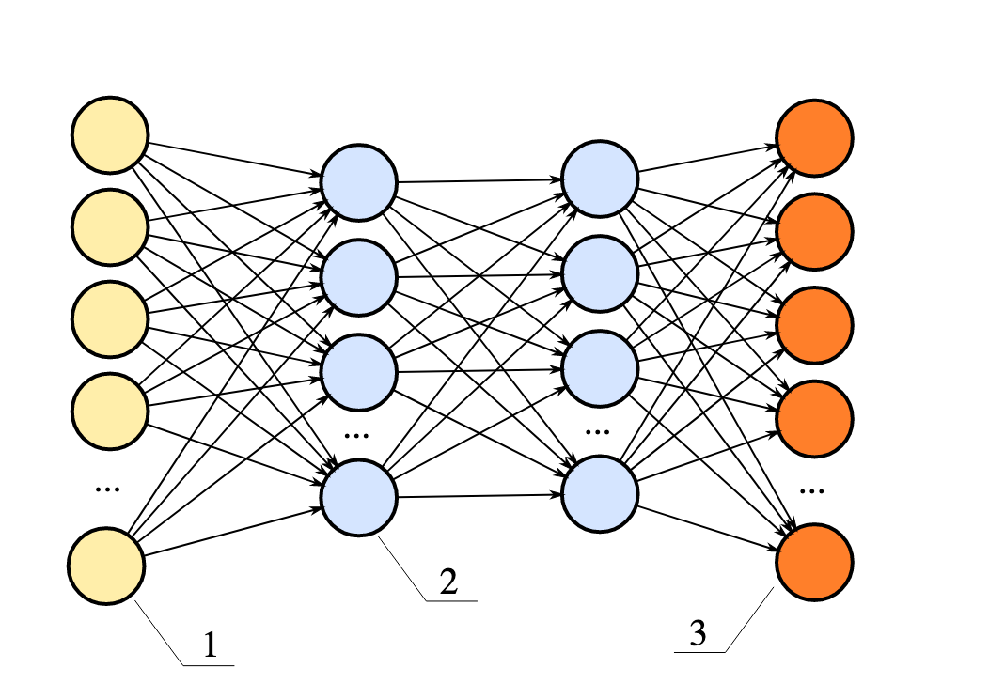
D(x) Y=1 or
D(G(z)) Y=0
Real Data (P_{x})
x
Discriminator (D)
Noise (P_{z})
G(z)
Generator (G)

Slide 13
Training GANs
04

Slide 14
Training GANs
What can be trained ?
The Generator & Discriminator
What if we train the generator alone ?
Overfitting - similar to VAEs
What if we train the discriminator alone?
Makes no sense because we need the generator eventually

Slide 15
Training GANs
Can we train both neural networks at the same time ?
No, Training won’t happen. Inability to converge
What is the solution?
Train both the networks one at a time

Slide 16
Loss Function
05

Slide 17
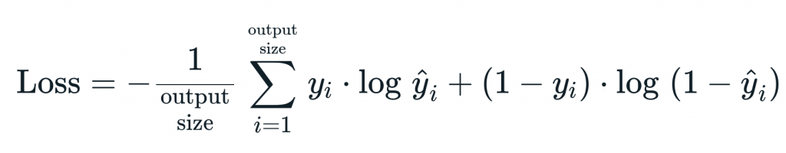
Binary Cross Entropy / Log Loss
Where....
y - Actual Output
ŷ - Predicted Output

Slide 18
Consider a Sample from Real Data :
y = 1, ŷ = D(x)
Therefore,
Loss = y.log(ŷ) + (1-y).log(1-ŷ)
= 1.log(D(x)) + (1-1)log(1-D(x))
= log(D(x))
0
Loss = log(D(x))

Slide 19
Consider a Sample from Generator :
y = 0, ŷ = D(G(z))
Therefore,
Loss = y.log(ŷ) + (1-y).log(1-ŷ)
= 0.log(D(G(z))) + (1-0)log(1-D(G(z)))
= log(1-D(G(z)))
0
Loss = log(1 - D(G(z)))

Slide 20
Combined Loss Function To Maximise
Loss = V(G,D) = log( D(x) ) + log( 1 - D(G(z)) )
Also Called Value Function

Slide 21
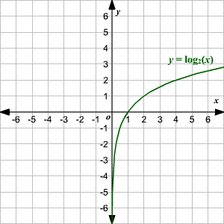
Between 0 and 1, y is maximum at x=1
Hence, for Loss to be maximum, D has to be maximised
Graph of y =log(x)

Slide 22
Extending the analogy,
1-G(z) should be maximum for loss to be maximum
Hence, G(z) should be minimum
Therefore, in order to maximise the loss function, D needs to be maximised and G needs to be minimised
Loss = min max V(G,D) = log( D(x) ) + log( 1-D(G(z)) )
G
D

Slide 23
Limitations Of GANs
06

Slide 24
Problem of Vanishing Gradients
Derivatives of the network weights and biases of the Generator become zero
Earlier on, the generator is very lousy
Discriminator rejects sample with D(G(z)) ~ 0

Slide 25
Problem of Vanishing Gradients
Loss for Generator : (Early on)
log (1-D(G(z)) = log(1) = 0
Consequently, derivative of loss function also becomes 0
Solution:
Instead of minimizing log(1-D(G(z)) ,
maximise log(D(G(z))

Slide 26
Inability To Converge
Typical GAN - Generator confuses the Discriminator
Discriminator feedback gets less meaningful over time
Over time, generator trains on junk feedback.
Essentially the error back-propagated to the generator makes no sense

Slide 27
Mode Collapse
Generator learns only some features and after a point of time in training, it produces the same output
Most of the real world distributions of data are complicated
Common in datasets with multimodal distributions
The generator learns only unimodal features and does not focus on other peaks

Slide 28
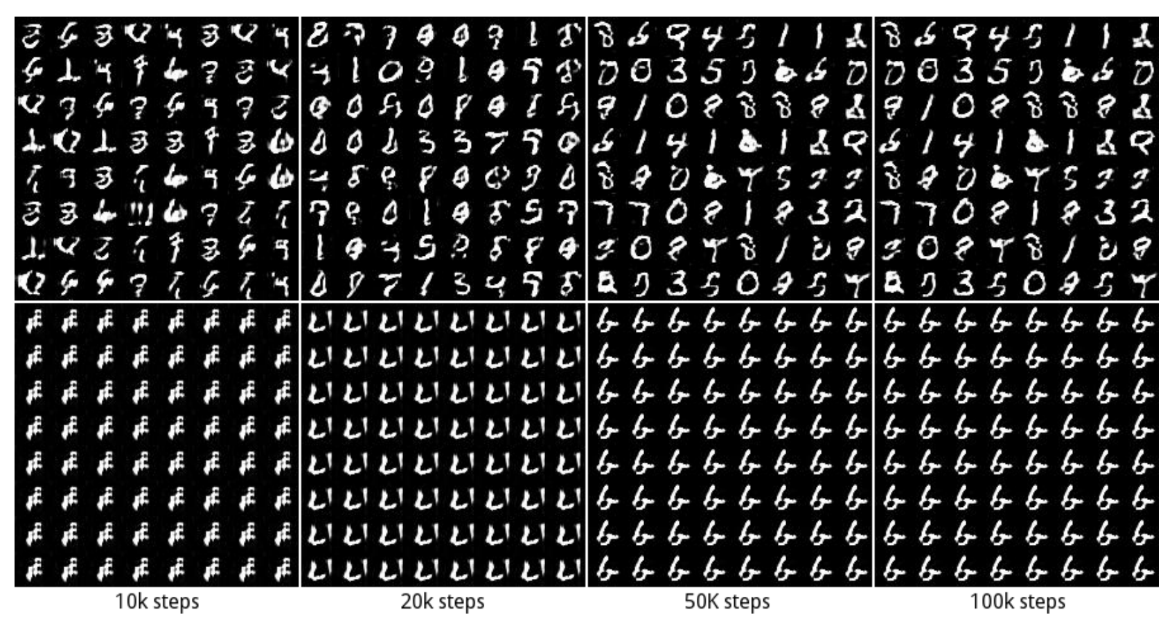

Slide 29
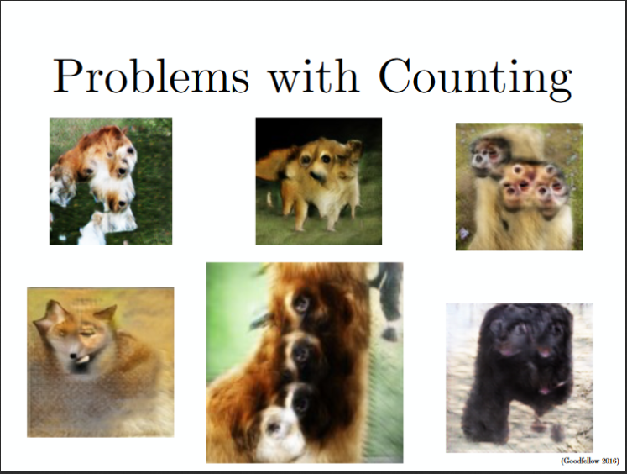

Slide 30
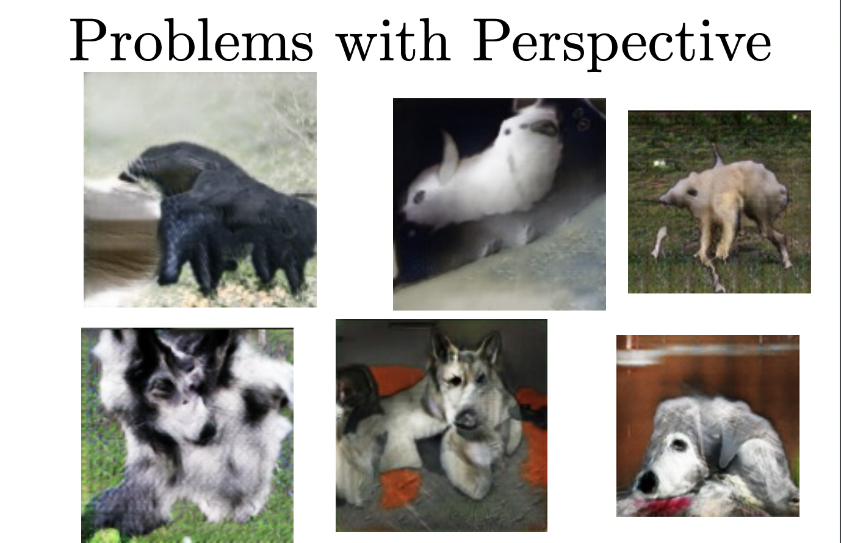

Slide 31
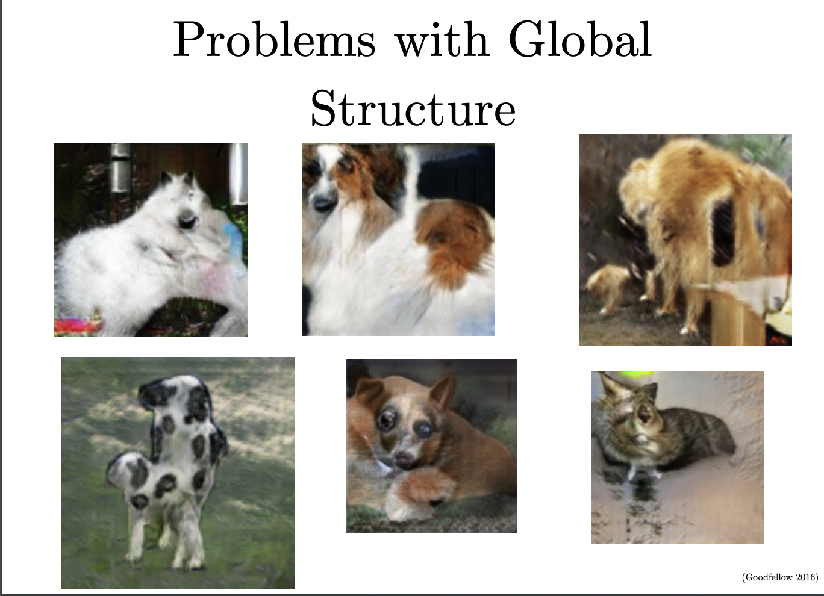

Slide 32
